Slide 1

Decoding Cricket's Evolution
A time travel through 1996 – 2005 matches
Team :
Abhishek Reddy Gorla
Amulya Ambati
Lakshmi Prasanna Poluru
Venkata Harshith Nikhil Samudrala
Sai Vamshi Challamala
Sneha Sasanapuri

Slide 2
Contents
Introduction
Structure of cricket & ODI
Terminology
Data
Source & Collection
Prep & Cleaning methods
Primary attributes
Our Research Questions
Visualizations
Statistical Tests
Results

Slide 3
Introduction to terms
2 teams – 11 players
Toss
Batting team – Chasing team
One Day International
50 overs – 6 balls / over
Two Innings
Margin of win

Slide 4


Data source and collection
GitHub
Original source - ESPN Cricinfo
Live cricket data from various sources
Cricket boards
Broadcasters
On-site reporters
Span: 1996 – 2005
Preparation and Cleaning
Addressed missing values in columns like 'ball remaining,' 'margin,' 'margin type,' 'series.'
Replaced NAs with values [0, 0, 'default', 'NatWest'] for uniformity.

Slide 5
Primary attributes for analysis
Teams
Score and Wickets
Series Information
Toss decision & country
Margin (wickets and runs)
Match Winner
Home or Away Match
Player of the match
Place & Time of match

Slide 6
Our Research questions
Does India’s batting average exhibit a notable difference when playing against Pakistan compared to its batting average against South Africa?
Is there an increased likelihood of winning the match for teams that win the toss?
Is there a variance in a country’s likelihood of winning when playing at a neutral ground (a location not belonging to either of the participating countries) compared to playing at the home ground of the opponent’s country?

Slide 7
Visualizations

Slide 8
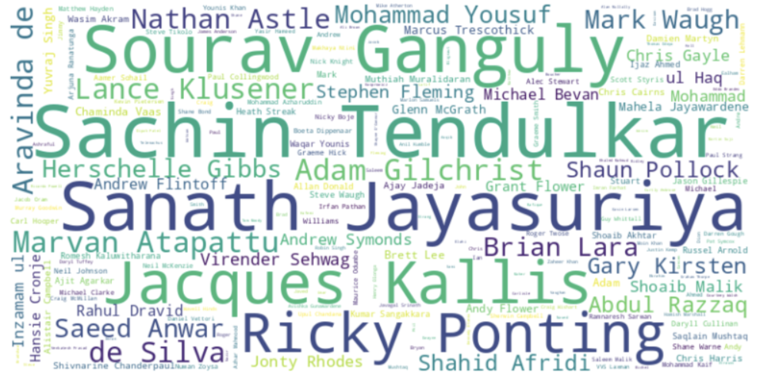
Player of the match
39
Sachin Tendulkar
India
24
Jacques Kallis
Zimbabwe
33
Sanath Jayasuriya
Sri Lanka
21
Ricky Ponting
Australia
30
Word Cloud
Sourav Ganguly
Based on frequency – Word sizing
India
Top 5 cricketers

Slide 9
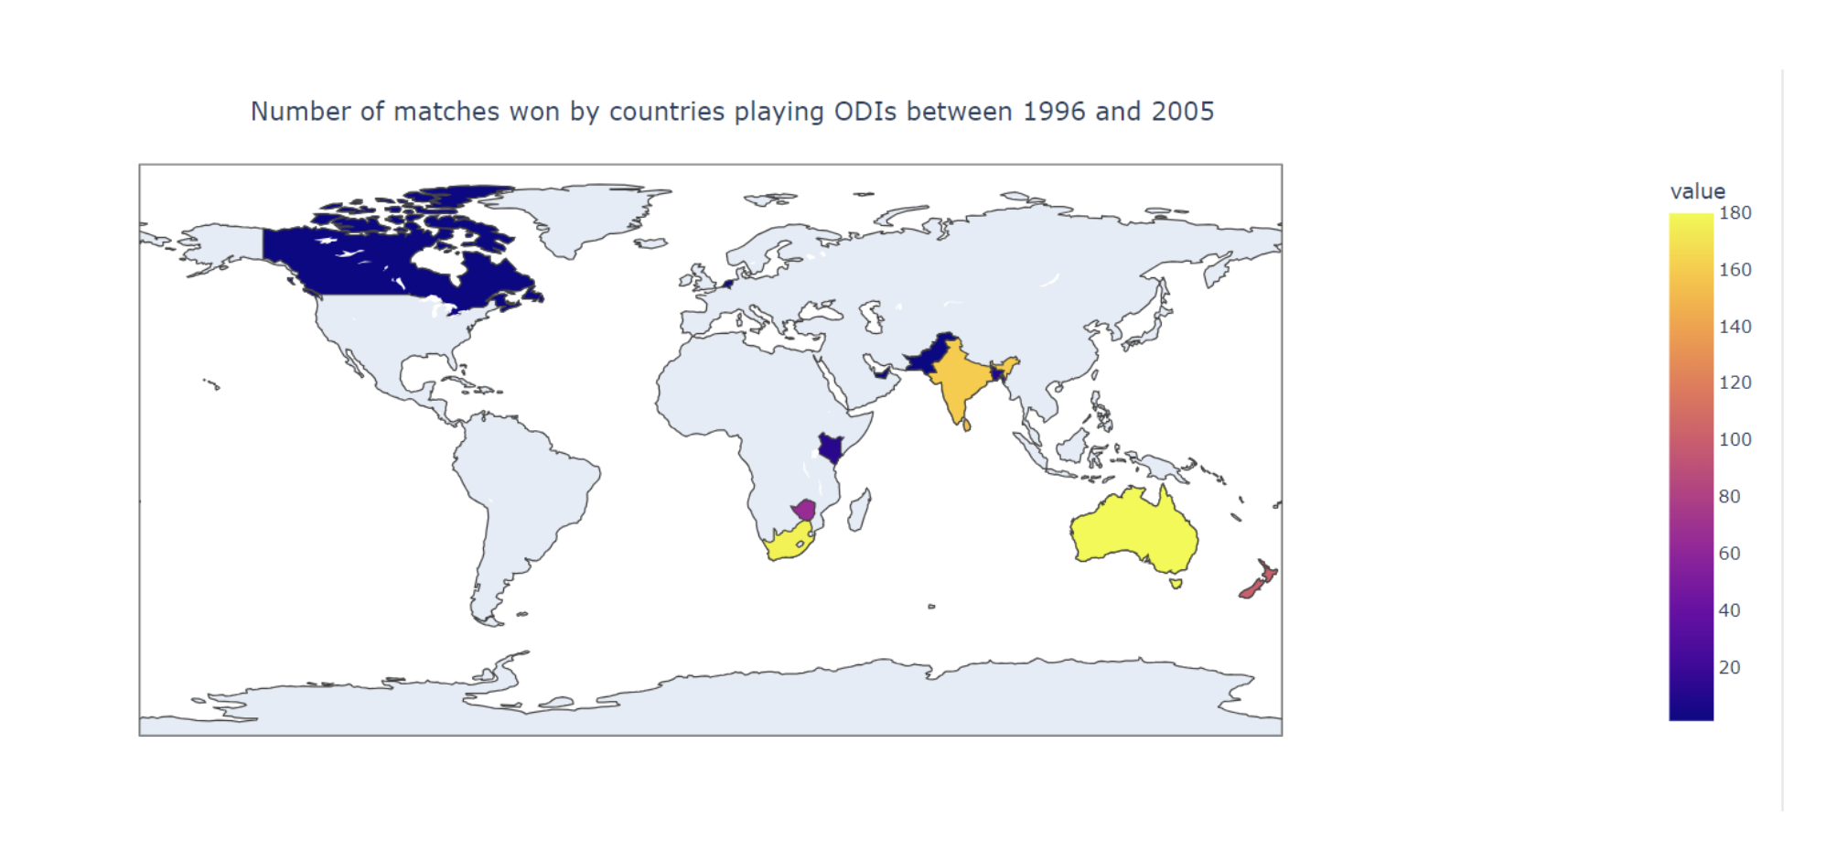
Global Distribution of ODI Match Wins (1996-2005)
India
160
South Africa
177
Australia
180
Australia & South Africa
won most of the matches

Slide 10
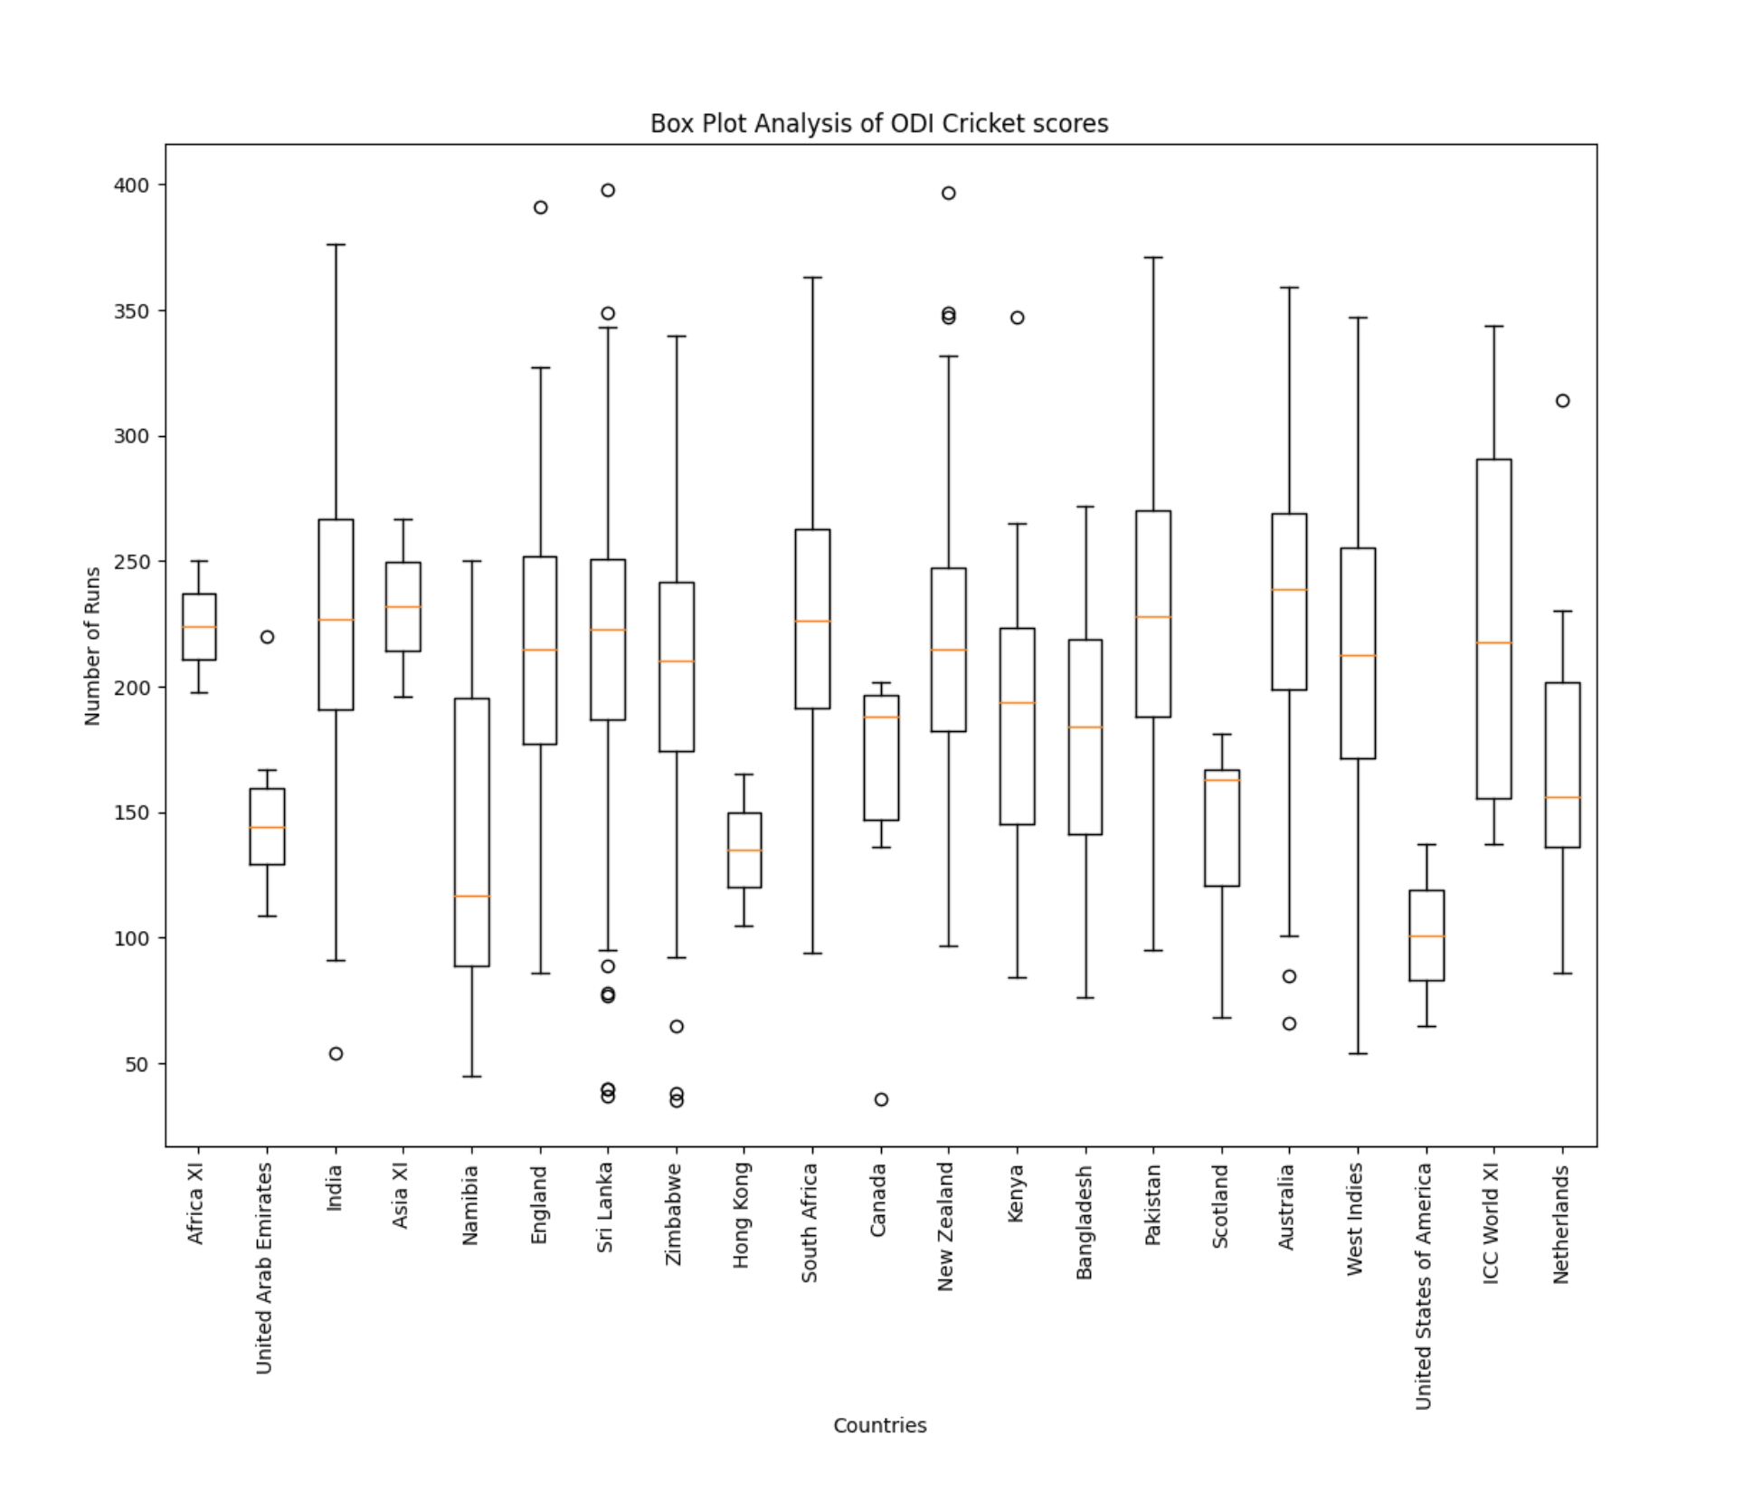
Box Plot Analysis of ODI Cricket Scores
Australia – Highest median score
New Zealand – Exceptional batting - outlier of 397 runs
Canada - < 50 runs against Sri Lanka

Slide 11
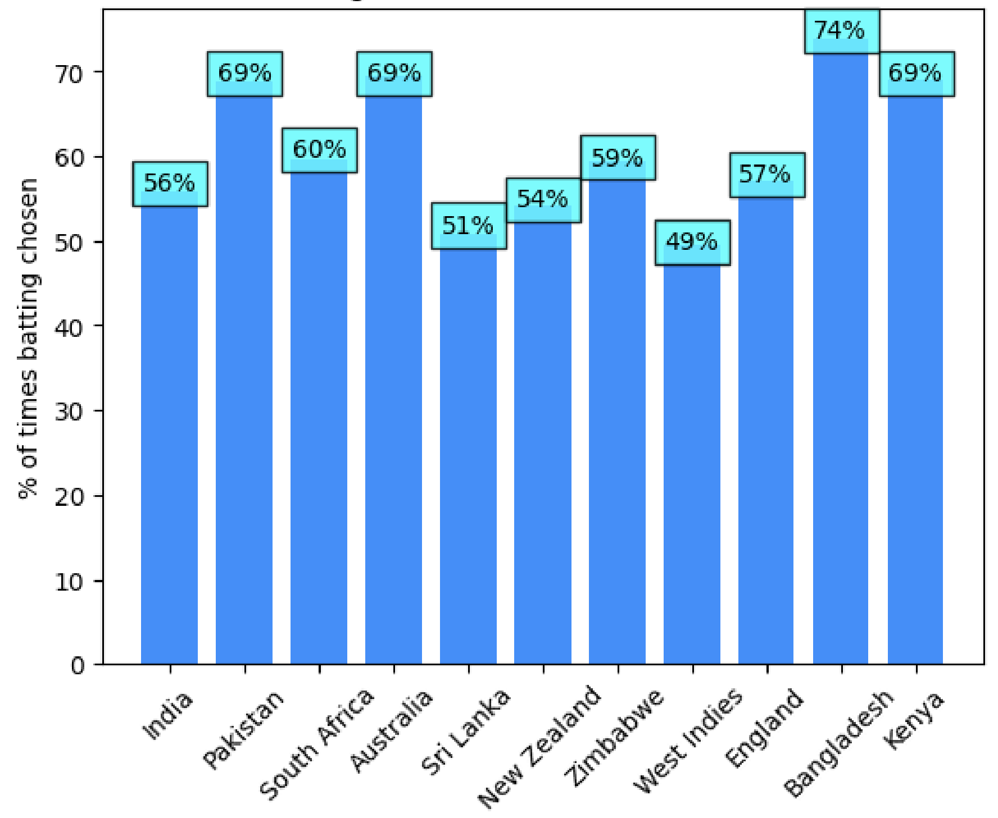
Is batting the first choice of toss winners?
Pakistan, Australia, Bangladesh, and Kenya - opted 'bat first' in nearly 70% of their toss victories
West Indies and Sri Lanka – A balanced approach

Slide 12
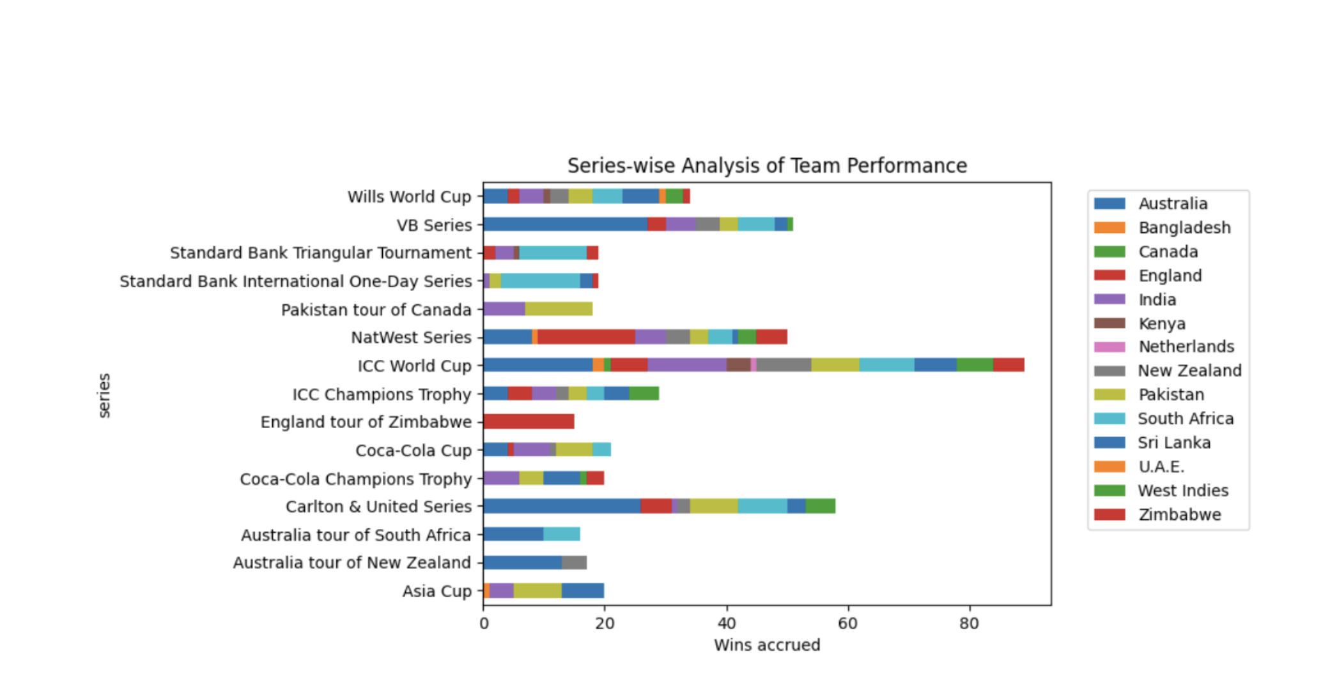
Series-wise Analysis of Team Performance
Australia and India - notable leadership in the ICC World Cup
Australia excelled in VB series and Carlton & United series

Slide 13
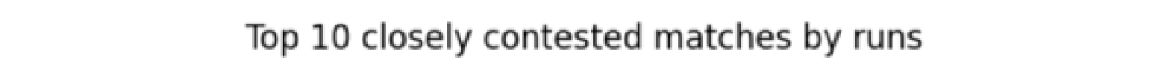

Strongest opponent
By runs
Zimbabwe – 4 times out of top ten most fiercely contested matches

Slide 14
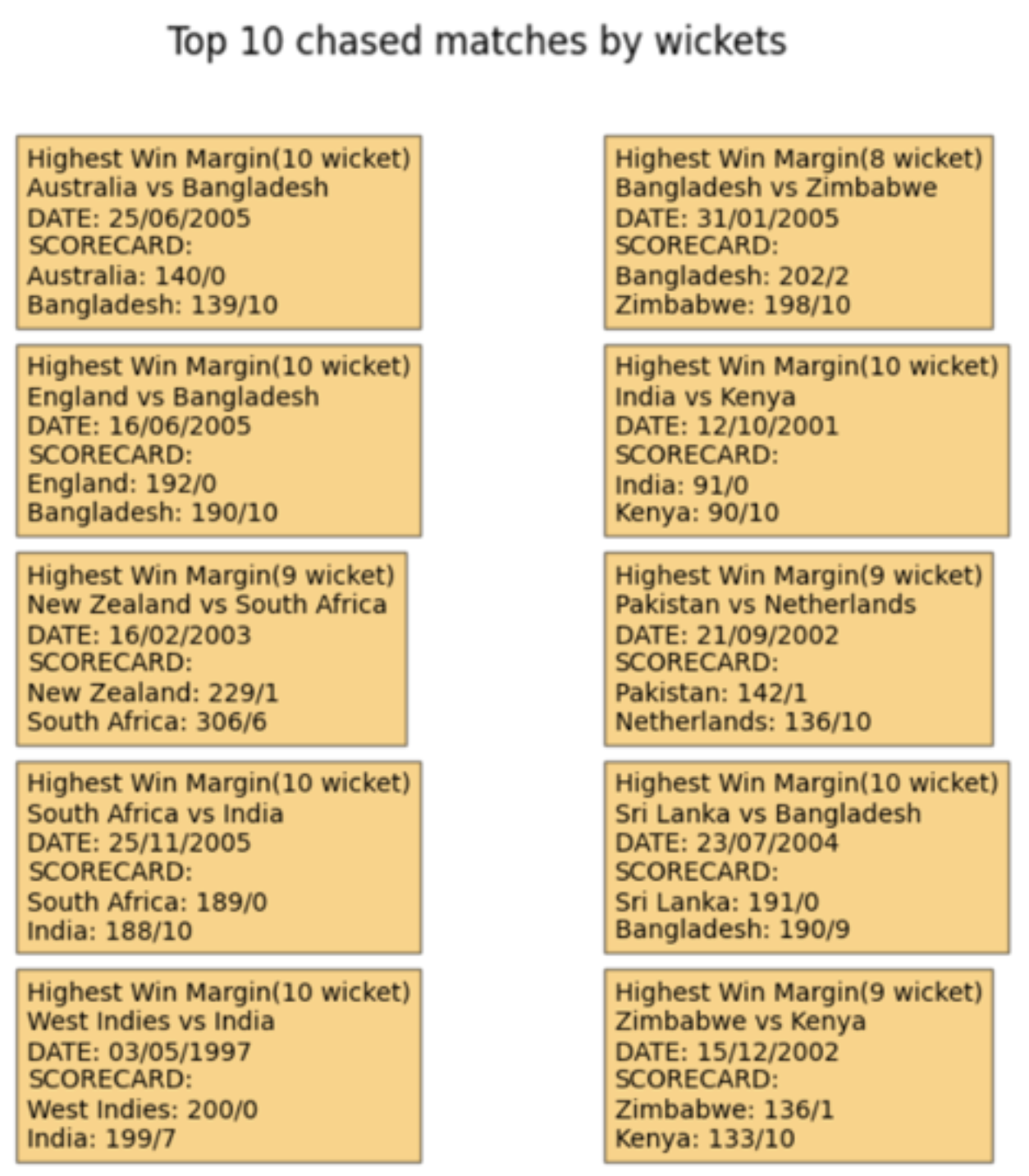
Strongest Opponent
By wickets
Wins by 10 wickets - dominant victory with both openers remaining not out
Bangladesh – 3 losses among top 10 successful chase matches
Highest wicket margin
Poor batsman ship or opponent’s excellent bowling spirit

Slide 15
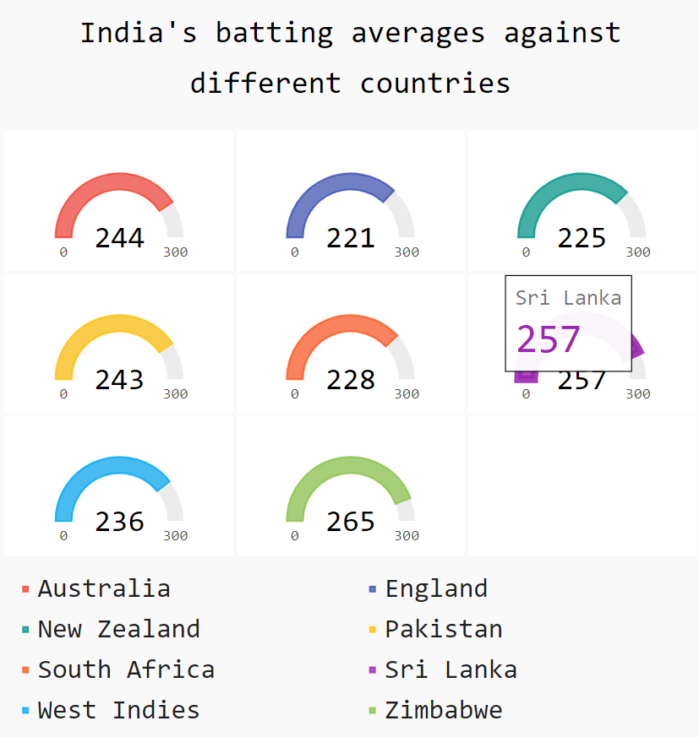
India’s batting averages
Highest batting averages when facing Zimbabwe, Sri Lanka, and Australia
Lower batting averages against England and New Zealand

Slide 16
Statistical Tests & Results

Slide 17
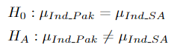
Test-1: Does India’s batting average exhibit a notable difference when playing against Pakistan compared to its batting average against South Africa?
Data considered : India batted first matches only
Sample size reduced
Can’t apply Z-test
Checked for normality of data with metric –
Mean-Min = Max-Mean ~ k* sd
Null
Alternate

Slide 18
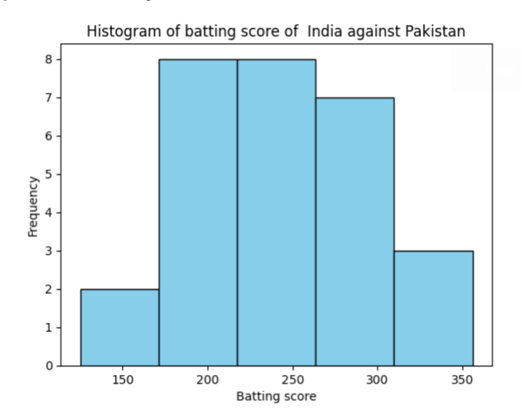
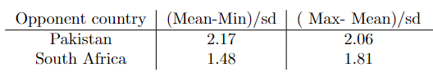
Test-1 (Cont..)
Followed approximately normal distribution
Two-sample mean test
Can apply t-test
α= 0.05 → Significance level
p-value = 0.29 > Significance level
Failed to reject null Hypothesis
India’s batting average against Pakistan is significantly different from India’s batting average against South Africa

Slide 19
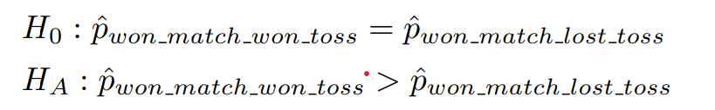
Test-2: Is there an increased likelihood of winning the match for teams that win the toss?
Null
Alternate
Two-sample proportion test
α= 0.05 → Significance level
p-value = 0.3 > Significance level
Failed to reject null Hypothesis
Toss winners don’t have a higher chance of winning the match

Slide 20
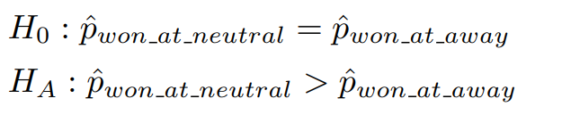
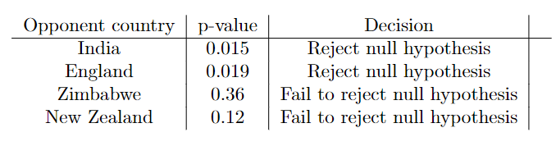
Test-3: Is there a variance in a country’s likelihood of winning when playing at a neutral ground compared to playing at the home ground of the opponent’s country?
Null
Alternate
Two-sample proportion test
α= 0.05 → Significance level
p-value for 4 countries
Rejected null Hypothesis
India, England:
Proportion of wins at the neutral ground is greater than the opponent’s home ground
Fail to reject null Hypothesis
Zimbabwe, New Zealand:
Proportion of wins at the neutral ground is not greater than the opponent’s home ground

Slide 21
Thank You

